Slide 1



Banglar Heshel: A Comprehensive Restaurant Management System
IUBAT–INTERNATIONAL UNIVERSITY OF BUSINESS AGRICULTURE AND TECHNOLOGY
Founded 1991 by Md. Alimullah Miyan
Practicum Defense
Prepared for: Practicum Defense Committee Department of Computer Science and Engineering
Prepared by:
Tomal Mujumder
ID: 22103038
Supervised by:
Toyeer-E-Ferdoush
Assistant Professor
Date: 22/01/2026

Slide 2
Table of contents
Organization Overview
Project Introduction
Objectives of this Project
Process Model
Feasibility Study
Requirement Engineering
Use Case Diagram
Software Analysis Pattern
Activity Diagrams
Swim-lane Diagrams
Sequence Diagrams
Class Diagram
02

Slide 3
Table of contents (Cont.)
Risk Management
Function Point Analysis
Task Scheduling
Data Flow Diagram
ER Diagram
System Quality Assurance
System Testing
Ethical Considerations
Project Demonstration
Limitation of The Project
Conclusion & Future Scope
03

Slide 4
Organization Overview
Soft-Tech Solutions (Tech Solutions)
Nature: Software development and logistics technology company.
Services:
Enterprise Resource Planning (ERP) Solutions
Custom Software Development
Cloud Computing & Mobile App Development
Vision: To be a recognized technology provider supporting business growth through reliable software.
Mission: delivering tailored software solutions and developing new talent through mentorship.
My Role: Software Developer Intern (Full-stack focused, MERN Stack, Database Design).
04

Slide 5
Project Introduction
Problem Statement:
Fragmentation in restaurant operations (manual order taking, paper-based reservations).
Lack of integrated digital platform for menu management and online ordering.
Inefficiency in inventory tracking leading to stock-outs and wastage.
Solution - "Banglar Heshel – A Comprehensive Restaurant Management System":
A full-stack web-based platform streamlining restaurant operations from menu to payment.
Integrates online ordering, table reservations, inventory management, and customer reviews.
Prioritizes efficiency (real-time stock alerts) and transparency (token-based order tracking, email confirmations).
Technology:
MERN Stack (MongoDB, Express.js, React.js, Node.js), SSLCommerz Payment Gateway, Cloudinary Image Storage, Nodemailer Email Service, Firebase Authentication.
05

Slide 6
Objectives of this Project
Broad Objective:
Design and develop a scalable, secure, full-stack platform to streamline restaurant operations and enhance customer experience.
Specific Objectives:
Architecture: Implement a modular MERN Stack Architecture using MongoDB, Express.js, React.js, and Node.js.
Payment Integration: Integrate SSLCommerz Payment Gateway for secure online transactions with multiple payment methods.
Cloud Storage: Implement Cloudinary APIs for efficient multi-image upload, storage, and CDN delivery.
Analytics: Create comprehensive dashboards with Recharts for sales trends, revenue patterns, and business insights.
06

Slide 7
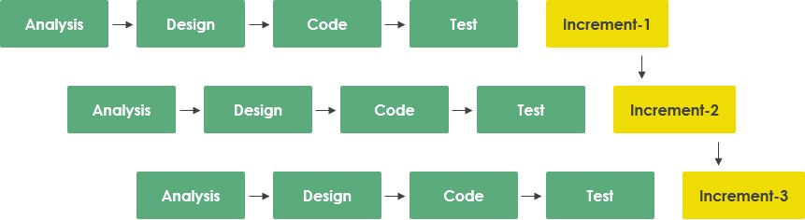
Process Model
Model Selected: Incremental Process Model.
Justification:
Validated core modules (Authentication & Menu Management) in Increment 1 before advanced features like payment gateway integration.
Allowed incorporation of user feedback between increments.
Enabled distinct focus on Authentication, Inventory Control and Payment modules.
07

Slide 8
Feasibility Study
Feasibility study means checking if a project is possible to build and useful before starting it.
Technical Feasibility:
Leveraged robust MERN stack with mature ecosystem..
Integrated API’s like SSLCommerz payment gateway, Cloudinary and Nodemailer.
Economic Feasibility:
Low upfront cost using open-source frameworks (MERN stack) and free-tier cloud services.
High ROI potential given restaurant management software market projected to reach USD 10 billion by 2030 with 11.8% CAGR.
Operational Feasibility:
Self-sustaining workflows with automated order notifications, email confirmations, payment receipts, and low-stock alerts.
Minimal manual intervention required for day-to-day operations with intuitive UI/UX design and role-based access control.
08

Slide 9
Requirement Engineering
Requirement Engineering is the process of understanding what the user wants from the system.
Requirements categorized into:
User Requirements
System Requirements
Functional Requirements
Non-Functional Requirements
09

Slide 10
User Requirements
Customer (User):
Account & Security: Email/password authentication with OTP verification. Google OAuth support.
Menu Browsing & Search: Browse by categories. Keyword search with filters. View food details and ratings.
Shopping Cart & Ordering: Manage cart and Wishlist. Place orders with token-based tracking.
Payments & Receipts: SSLCommerz integration. Automated PDF receipts. Unique order tokens.
Table Reservations: Book tables with date/time/party size. Email Confirmations.
Reviews & Ratings: Submit 1–5-star ratings and reviews. View and Delete own reviews.
10

Slide 11
User Requirements (Cont.)
Manager:
Food Management: Create, Update, Delete food items. Multi-image upload via Cloudinary. Manage categories and pricing.
Inventory Control: Real-time stock tracking. Set min/max thresholds. Automated low-stock alerts via email.
Order Management: View and process all orders. Verify orders using token numbers. Track payment status.
Reservation Management: View and manage table reservations. Update status (Pending/Confirmed/Cancelled). Daily reports.
11

Slide 12
User Requirements (Cont.)
Administrator:
User Management: View all users. Block/unblock accounts. Assign Manager roles.
System Analytics: Sales trends and revenue patterns. Popular menu items analysis. Payment statistics with visualizations (Recharts).
Full System Access: All manager features plus user administration. System-wide reporting and oversight.
12

Slide 13
System Requirements
Platform constraints:
Web-based application built on MERN stack.
Database management using MongoDB with Mongoose ODM for schema validation.
External Integrations:
SSLCommerz payment gateway for secure online transactions (Sandbox and Production).
Cloudinary API for cloud-based image storage, optimization, and CDN delivery.
Nodemailer with Gmail SMTP for OTP verification and email notifications.
Firebase for Google OAuth integration
System Capabilities:
JWT-based authentication with bcrypt password hashing and HTTP-only cookies.
Role-based access control (RBAC) for Admin, Manager, and User roles.
RESTful API architecture with separation of frontend, backend, and database layers.
Asynchronous Processing for email notifications, PDF generation and Image uploads.
13

Slide 14
Functional Requirements
Core Modules:
Multi-role registration with OTP email verification (User/Manager/Admin).
CRUD operations for food items with multi-image upload (up to 6).
Ordering Lifecycle:
Menu browsing → Cart → Order → Payment → Token → Confirmation.
Shopping cart and Wishlist management.
Payment & Tracking:
SSLCommerz integration with multiple payment methods.
Unique token generation and automated PDF receipts.
Inventory Management:
Auto stock creation with min/max thresholds. Low-stock email alerts
Analytics Dashboard & Table Reservations:
Sales trends, revenue patterns, and payment statistics (Recharts). Book with date/time/party size and manual confirmation.
14

Slide 15
Non-Functional Requirements
Security:
Bcrypt password hashing and HTTPS enforcement.
Role-Based Access Control (RBAC) for data isolation.
Performance:
API response times < 2 seconds, page loads < 3 seconds.
Asynchronous processing for high-latency tasks (email, PDF, uploads).
Reliability & Scalability:
ACID principles for critical transactions (payments, orders).
Modular MERN architecture supporting horizontal scaling.
Usability:
Fully responsive design (mobile/tablet/desktop).
Clear feedback loops (success/error notifications, loading indicators).
15

Slide 16
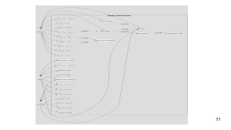
Use Case Diagram
Actors & Key Use Cases:
Customer: Login/Registration, Manage Profile, Browse Menu, Search Food Items, Add to Cart/Wishlist, Place Order, Make Payment, Reserve Table, Submit Review & Rating, View Order History.
Provider: Manage Food Items (CRUD), Upload Food Images, View Payments, Manage Reservations, Update Stock Levels, Manage Suppliers, Create Purchase Orders, View Analytics Dashboard, Generate Reports..
Admin: Manage Food Categories, Manage Users (Block/Unblock), Add/Delete Managers, View System Analytics and Full System Oversight.
16

Slide 17
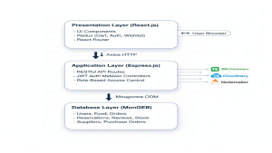
Software Analysis Pattern
Architecture: MERN Stack Architecture.
Structure:
Presentation Layer: React.js with Redux state management and React Router.
Application Layer: Node.js + Express.js with RESTful APIs, JWT auth, and business logic.
Database Layer: MongoDB + Mongoose with schema validation and indexing.
External Services: SSLCommerz (payments), Cloudinary (images), Nodemailer (email), Firebase (OAuth)
Benefit: Separation of concerns, scalability, and maintainability.
17

Slide 18
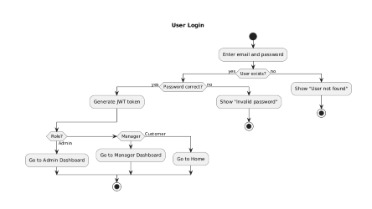
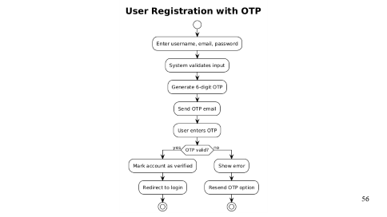
Activity Diagrams
Figure: User Registration
Figure: User login
18

Slide 19
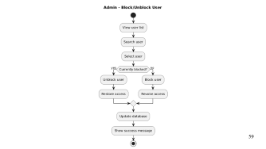
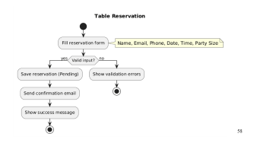
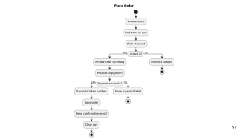
Activity Diagrams (Cont.)
Figure: Place Order
Figure: Table Reservation
Figure: User Management
19

Slide 20
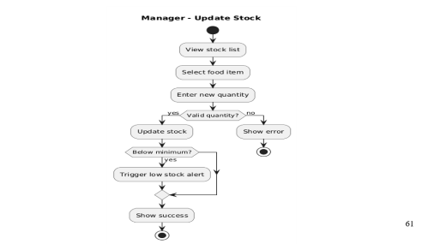
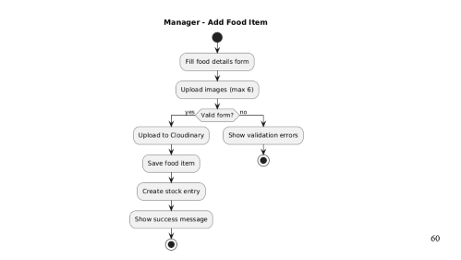
Activity Diagrams (Cont.)
Figure: Add Food Items
Figure: Update Stock
20

Slide 21
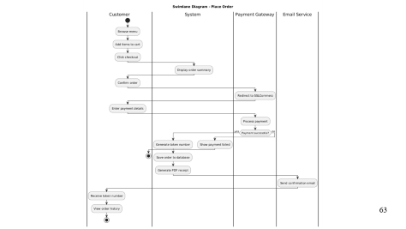
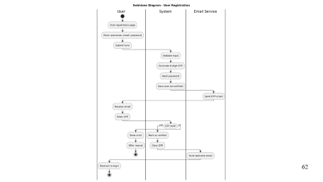
Swim-lane Diagrams
Figure: User Registration
Figure: Place Order
21

Slide 22
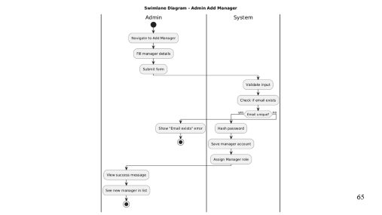
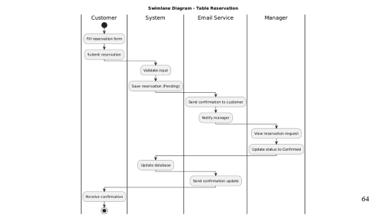
Swim-lane Diagrams (Cont.)
Figure: Table Reservation
Figure: Add Manager
22

Slide 23
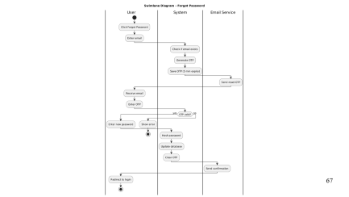
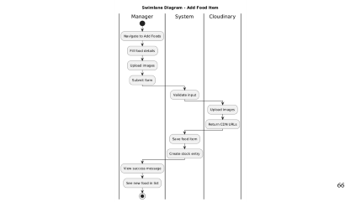
Swim-lane Diagrams (Cont.)
Figure: Add Food Items
Figure: Forgot Password
23

Slide 24
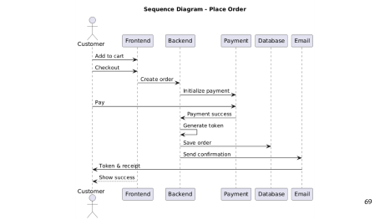
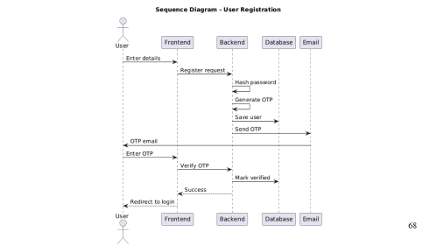
Sequence Diagrams
Figure: User registration
Figure: Place Order
24

Slide 25
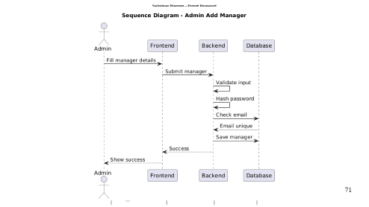
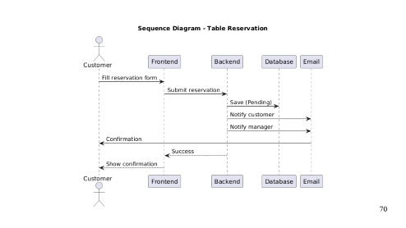
Sequence Diagrams (Cont.)
Figure: Table Reservation
Figure: Add Manager
25

Slide 26
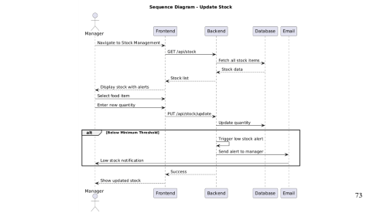
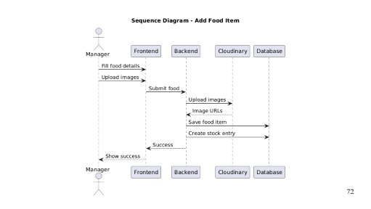
Sequence Diagrams (Cont.)
Figure: Add Food Item
Figure: Update Stock
26

Slide 27
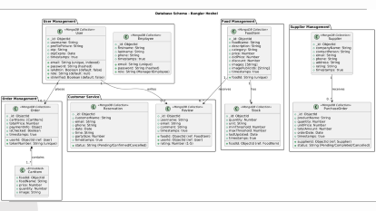
Class Diagram
Relationships:
User → Orders: One user can place multiple orders
User → Reviews: One user can submit multiple reviews
Food Item → Reviews: One food item can receive multiple reviews
Food Item → Stock: One food item has one stock record (1:1)
Order → Cart Items: One order contains multiple cart items (embedded array).
Supplier → Purchase Orders: One supplier can receive multiple purchase orders.
Food Items → Category: Many food items belong to one category.
SSLCommerz: Referenced in Order (payment info).
Cloudinary: Referenced in Food Item and User (image URLs).
Nodemailer: Triggered by system events (not stored).
Firebase: Used for Google OAuth (user data in User collection).
27

Slide 28
Risk Management: Technical Risk
Technical Risk (R1) | Date: 12-01-2026
Name | Email Delivery Failures
Impact | High (OTP verification and order confirmations fail)
Description | Nodemailer with Gmail SMTP dependency: emails marked as spam, account suspension, OTP delivery delays.
Mitigation & Monitoring | App-specific passwords. Retry queue for failed emails. OTP expiry (5 minutes). HTML templates. Rate limiting. Track delivery rates and monitor Gmail account.
Management | Backup email service (SendGrid) ready. Monitor delivery logs and OTP generation
Status | Monitor (Active with fallback prepared)
28

Slide 29
Risk Management: Operational Risk
Operational Risk (R2) | Date: 12-01-2026
Name | Data Loss or Corruption
Impact | High (Critical data loss: orders, payments, reservations)
Description | Database failures without proper backup mechanisms could result in permanent data loss.
Mitigation & Monitoring | MongoDB Atlas automated backups. Point-in-time recovery enabled. Mongoose schema validation. Track backup status and storage health.
Management | Verify backup integrity regularly. Monitor storage capacity. Implement transaction rollback procedures..
Status | Mitigated (Automated backups configured)
29

Slide 30
Risk Management: Business Risk
Business Risk (R4) | Date: 12-01-2026
Name | Payment Gateway Failure
Impact | High (Financial Loss & Trust)
Description | SSLCommerz integration errors in production leading to failed transactions and order processing disruption.
Mitigation & Monitoring | Extensive testing in Sandbox environment. Real-time alerts for failed transactions. Webhook validation and error handling.
Management | Manual dispute resolution protocol. Transaction reconciliation. Fallback mechanisms for payment verification.
Status | Mitigated (Sandbox validated, production monitoring active)
30

Slide 31
Function Point Analysis
Metrics: Measures software size based on functionality provided to the user.
Components:
Internal Logical Files (ILF): Users, Food Items, Orders, Reservations, Reviews, Stock, Suppliers, Purchase Orders (High Complexity).
External Interface Files (EIF): SSLCommerz, Cloudinary, Nodemailer, Firebase APIs.
Transactional Functions: User Registration (OTP), Place Order (Payment), Menu Browsing, Stock Updates (EI/EO/EQ).
Calculation:
Total Unadjusted Function Points (UFP) = 197
Total Degree of Influence (TDI) = 55
Value Adjustment Factor (VAF) = 0.65 + (0.01 × 55) = 1.10
Adjusted Function Points (AFP) = 197 × 1.10 ≈ 217 FP.
Estimation: Effort = 217 ÷ 18 FP/month ≈ 12 person-months.
31

Slide 32
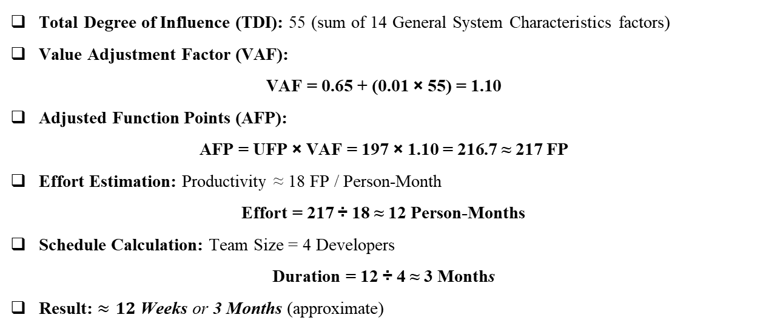
Function Point Calculation
Total Degree of Influence (TDI): 55 (sum of 14 General System Characteristics factors)
Value Adjustment Factor (VAF):
$$\text{VAF}\text{ = 0.65 + (0.01 × 55) = 1.10}$$
Adjusted Function Points (AFP):
$$\text{AFP}\text{ = }\text{UFP}\text{ × }\text{VAF}\text{ = 197 × 1.10 = 216.7 ≈ 217 }\text{FP}$$
Effort Estimation: Productivity ≈ 18 FP / Person-Month
$\text{Effort}\text{ = 217 ÷ 18 ≈ 12 }\text{Person}\text{-}\text{Months}$
Schedule Calculation: Team Size = 4 Developers
$$\text{Duration}\text{ = 12 ÷ 4 ≈ 3 }\text{Month}\text{s}$$
Result: $≈12 \text{Weeks} \text{or} \text{3 }\text{Months}$ (approximate)
32

Slide 33
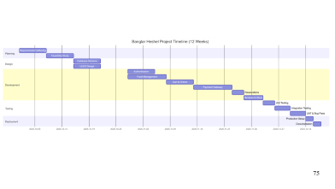
Task Scheduling
Project Timeline (12 Weeks: Oct 2025 – Jan 2026)
▪ Planning & Design (4 weeks): Requirements gathering, feasibility study, tech stack selection, database schema, ERD, and UI/UX design.
▪ Increment 1 (2 weeks): Authentication & User Profiles (OTP verification, JWT, role-based access).
▪ Increment 2 (2 weeks): Menu Management (CRUD operations, Cloudinary image upload, categories).
▪ Increment 3 (2 weeks): Shopping Cart & Ordering (cart management, order placement, payment integration with SSLCommerz).
▪ Increment 4 (2 weeks): Reservations & Reviews (table booking, email confirmations, rating system).
▪ Increment 5 (2 weeks): Inventory & Analytics (stock tracking, low-stock alerts, supplier management, dashboard with Recharts).
▪ Testing & Deployment (2 weeks): Unit testing, integration testing, payment flow testing, UAT, bug fixing, production deployment, and documentation.
33

Slide 34
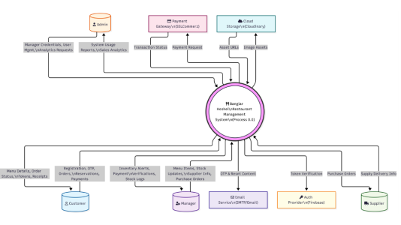
Data Flow Diagram
Level 0 (Context Level DFD):
Central System: Banglar Heshel Restaurant Management System
Customers: Register, browse menu, order, pay, reserve tables, submit reviews.
Managers: Manage food/stock, track payments/reservations, view analytics.
Admins: Manage users, assign roles, monitor system.
External Services: SSLCommerz (payments), Cloudinary (images), Nodemailer (emails/OTP), Firebase (OAuth)
34

Slide 35
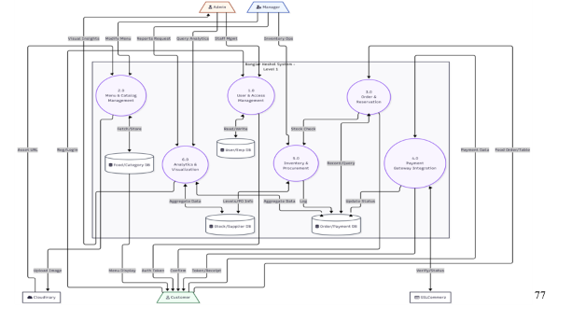
Data Flow Diagram (Cont.)
Level 1 DFD:
Manages user registration and login.
Handles service listings and search.
Processes booking requests and status.
Executes payment transactions.
Collects reviews and ratings.
Sends notifications and emails.
Admin controls and monitors system.
35

Slide 36
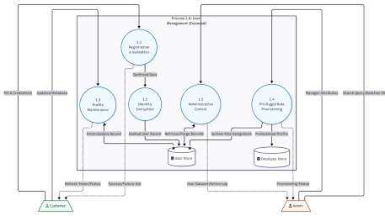
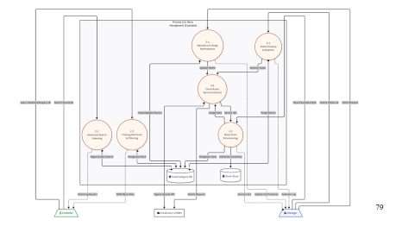
Data Flow Diagram (Cont.)
Level 1 DFD (process 1 & Process 2):
Figure: Process 1 – User Management
Figure: Process 2 – Menu Management
36

Slide 37
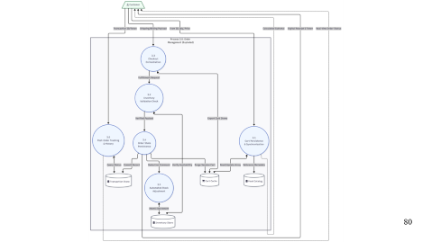
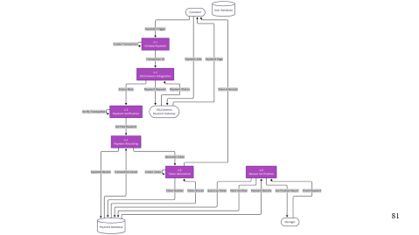
Data Flow Diagram (Cont.)
Level 1 DFD (Process 3 & Process 4):
Figure: Process 3 – Order Management
Figure: Process 4 – Payment Processing
37

Slide 38
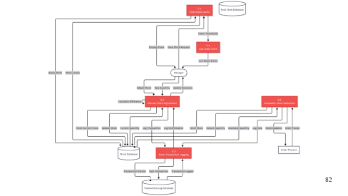
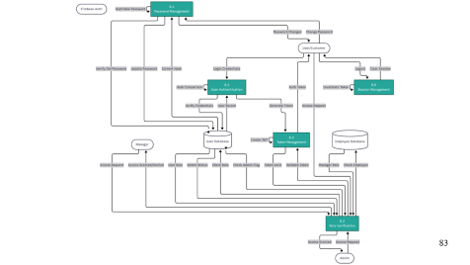
Data Flow Diagram (Cont.)
Level 1 DFD (process 5 & Process 6):
Figure: Process 5 – Stock Management
Figure: Process 6 – Authentication Processing
38

Slide 39
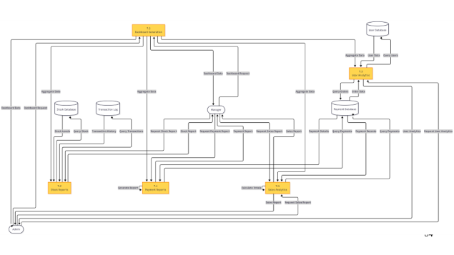
Data Flow Diagram (Cont.)
Level 1 DFD (process 7):
Figure: Process 7 – Admin Management
39

Slide 40
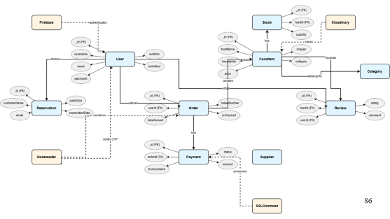
ER Diagram
Core User Relationships
User → Order
One user can place multiple orders.
User → Review
One user can write multiple reviews.
User → Reservation
One user can make multiple table reservations.
Food Item → Stock
One food item has exactly one stock record (1:1 relationship).
Food Item → Review
One food item can receive multiple customer reviews.
Order → Payment
One order has one payment transaction
40

Slide 41
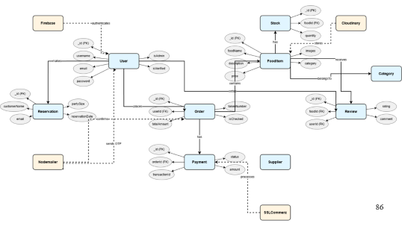
ER Diagram (Cont.)
Core Manager Relationships:
Order → FoodItem (CartItems)
One order contains multiple food items through embedded cart items array.
Employee/Manager → Order
One manager can process/manage multiple orders.
Employee/Manager → Stock
One manager can update multiple stock records.
Employee/Manager → FoodItem
One manager can create/manage multiple food items
Payment → SSLCommerz (External)
Payment transactions are processed through SSLCommerz gateway
41

Slide 42
ER Diagram (Cont.)
FoodItem → Cloudinary (External)
Food item images are stored on Cloudinary CDN.
User → Cloudinary (External)
User profile pictures are stored on Cloudinary.
User → Nodemailer (External)
Users receive OTP verification emails and notifications.
Order → Nodemailer (External)
Order confirmations are sent via email.
Reservation → Nodemailer (External)
Reservation confirmations are sent via email.
User → Firebase (External)
Users can authenticate using Google OAuth via Firebase
42

Slide 43
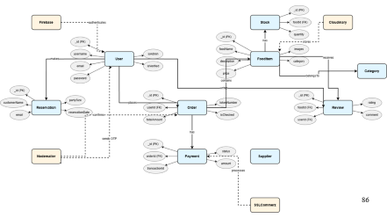
ER Diagram (Cont.)
Review → User
Each review is written by one specific user (author tracking).
Review → FoodItem
Each review is associated with one specific food item.
Order → User
Each order belongs to one customer (userId foreign key).
Payment → Order
Each payment is linked to one specific order (orderId foreign key).
Stock → FoodItem
Each stock record tracks inventory for one specific food item (foodId foreign key)
PurchaseOrder → Supplier
Each purchase order is placed with one specific supplier (supplierId foreign key)
43

Slide 44
System Quality Assurance
Quality Management Process
Design Validation: Ensuring the architectural blueprint (Database/Clean Architecture) was correct before writing code.
Error Monitoring: Actively finding and fixing logic errors (like payment bugs) during development.
Code Quality: Following rules (SOLID, Naming Conventions) to make the code clean and less prone to bugs.
Peer Reviews: Having others check your code to catch logical mistakes you might have missed.
Performance: Testing the system's speed to ensure it meets user expectations.
44

Slide 45
System Testing
Testing Scenario 1: User Registration
Scenario: | TC1: User registers with a valid email
Input’s: | Enter Name, Email, Password → Select "User" Role → Click Submit
Desired Output’s: | New account created in database, Confirmation Email sent to inbox, User redirected to Login page.
Actual Output’s: | Database record inserted, Email received with token, Redirect successful.
Verdict: | Passed (Registration flow works as intended).
45

Slide 46
System Testing (Cont.)
Testing Scenario 2: Service Booking
Scenario: | TC4: User books a service (Cleaning)
Input’s: | Select "Cleaner" Category → Choose Provider → Pick Date (12-01-2026) → Confirm
Desired Output’s: | Booking Request created with status "PendingProviderReview", Push Notification sent to Provider.
Actual Output’s: | Booking created in DB, Status updated to "Pending", Provider received in-app alert.
Verdict: | Passed (Booking lifecycle initiated correctly).
46

Slide 47
System Testing (Cont.)
Testing Scenario 3: Payment Processing
Scenario: | TC5: Processing payment for confirmed booking
Input’s: | Click "Pay Now" on Booking → Enter Sandbox Card Details → Submit
Desired Output’s: | SSLCommerz returns success, Validation ID stored, Booking status updates to "PaymentReceived".
Actual Output’s: | Transaction successful, VAL_ID stored in Payment table, Booking Status marked "Paid".
Verdict: | Passed (Payment integration validates transactions correctly).
47

Slide 48
Ethical Considerations
Data Privacy:
Minimization of location data collection (only when searching).
Strict encryption of PII and passwords.
Fairness:
Algorithm neutrality: Search ranks by Proximity and Rating, not ad spend.
Inclusivity:
Platform open to all skilled workers regardless of demographic.
AI Ethics:
Hugging Face prompts designed to generate neutral, professional content.
48

Slide 49
Project Demonstration
&
Question Answer Session
49

Slide 50
Limitation of the Project
Internet Dependency: Requires stable internet connection for all operations (no offline mode)
Payment Environment: Currently operates in SSLCommerz Sandbox mode; requires production setup for live deployment.
Mobile Features: Lack of native mobile app; no push notifications (Responsive Web App limitations).
Real-Time Updates: No WebSocket implementation; requires page refresh for order status and notifications.
Single Payment Gateway: Only supports SSLCommerz; lacks bKash, Nagad, Rocket, or Stripe integration.
Cloud Service Limits: Free-tier dependencies (MongoDB Atlas 512MB, Cloudinary 25GB) may face quota limitations.
Basic Analytics: Lacks advanced features like predictive analytics and customer segmentation
50

Slide 51
Conclusion
Summary:
Successfully developed "Banglar Heshel," a functional, secure, and modern restaurant management system.
Implemented MERN Stack Architecture, secure authentication with OTP, and robust order/payment workflows.
Integrated SSLCommerz payment gateway, Cloudinary image storage, and role-based access control.
Future Scope:
Native Mobile App: React Native development for push notifications and offline capabilities.
Real-Time Features: WebSocket (Socket.io) integration for live order tracking and notifications.
Advanced Analytics: Predictive forecasting, customer segmentation, and AI-powered recommendations..
51

Slide 52
Thank You

Slide 53
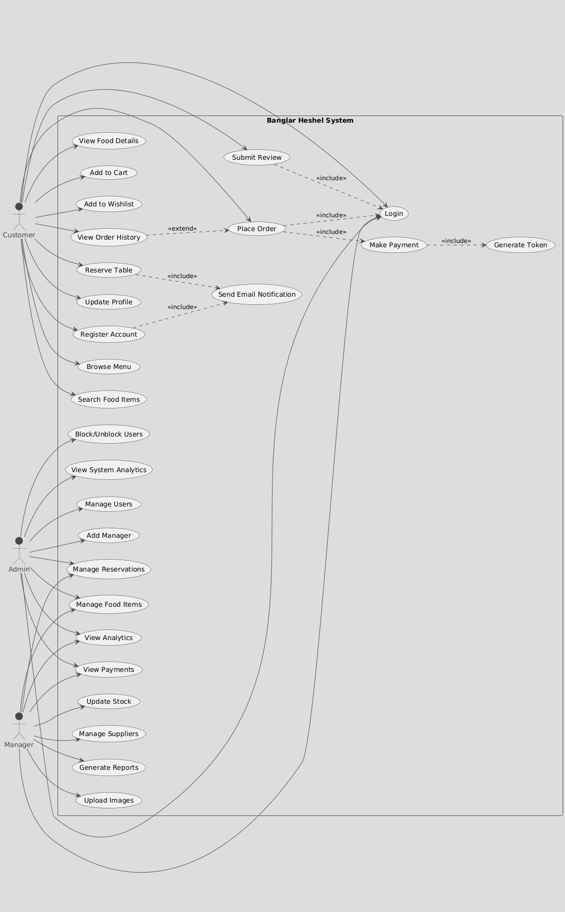
53

Slide 54
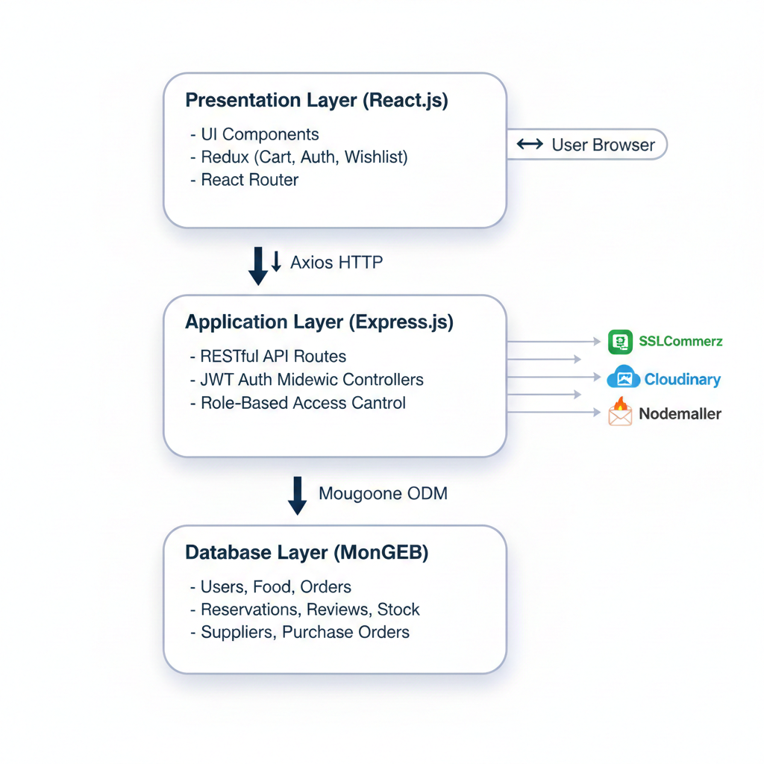
54

Slide 55
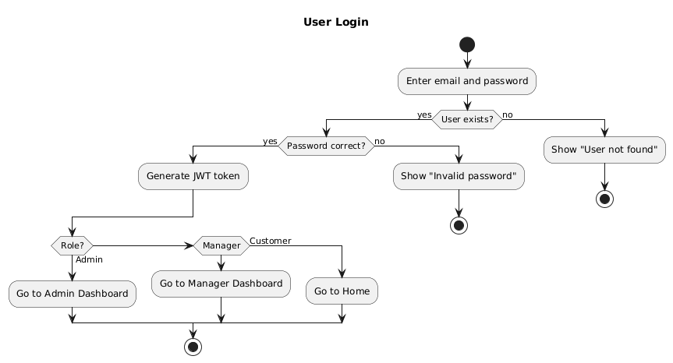
55

Slide 56
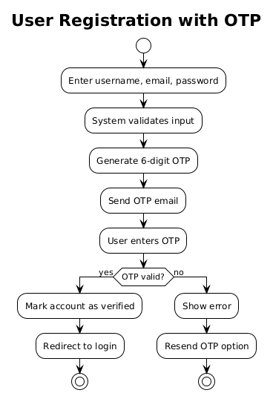
56

Slide 57
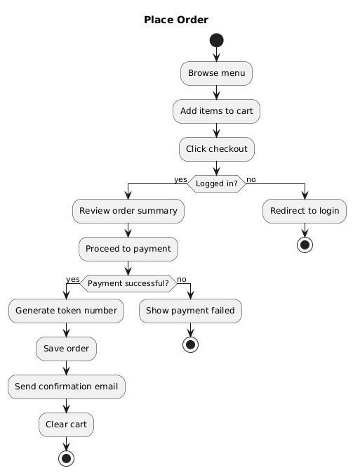
57

Slide 58
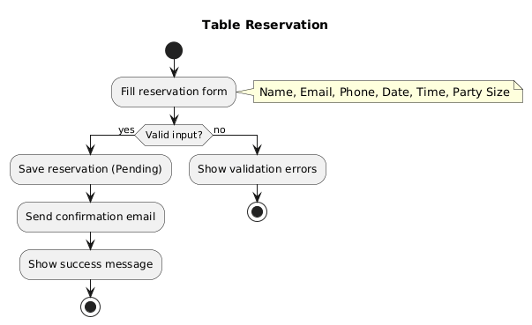
58

Slide 59
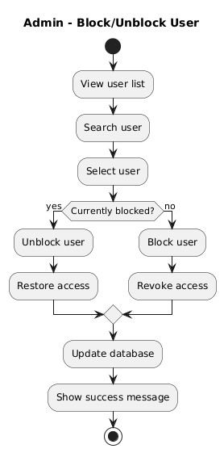
59

Slide 60
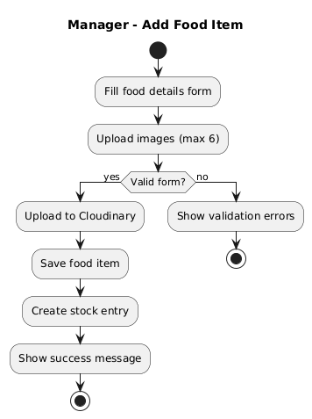
60

Slide 61
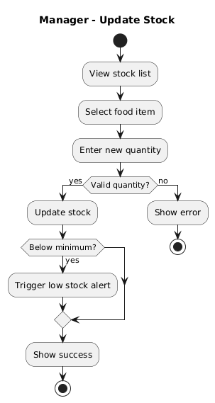
61

Slide 62
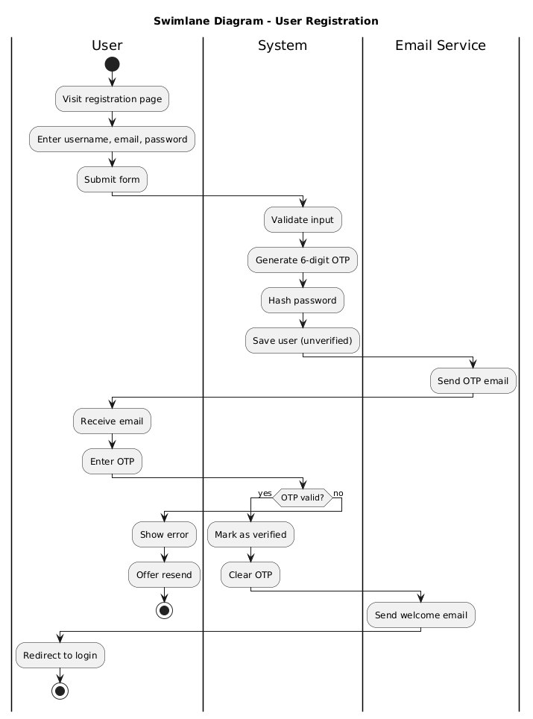
62

Slide 63
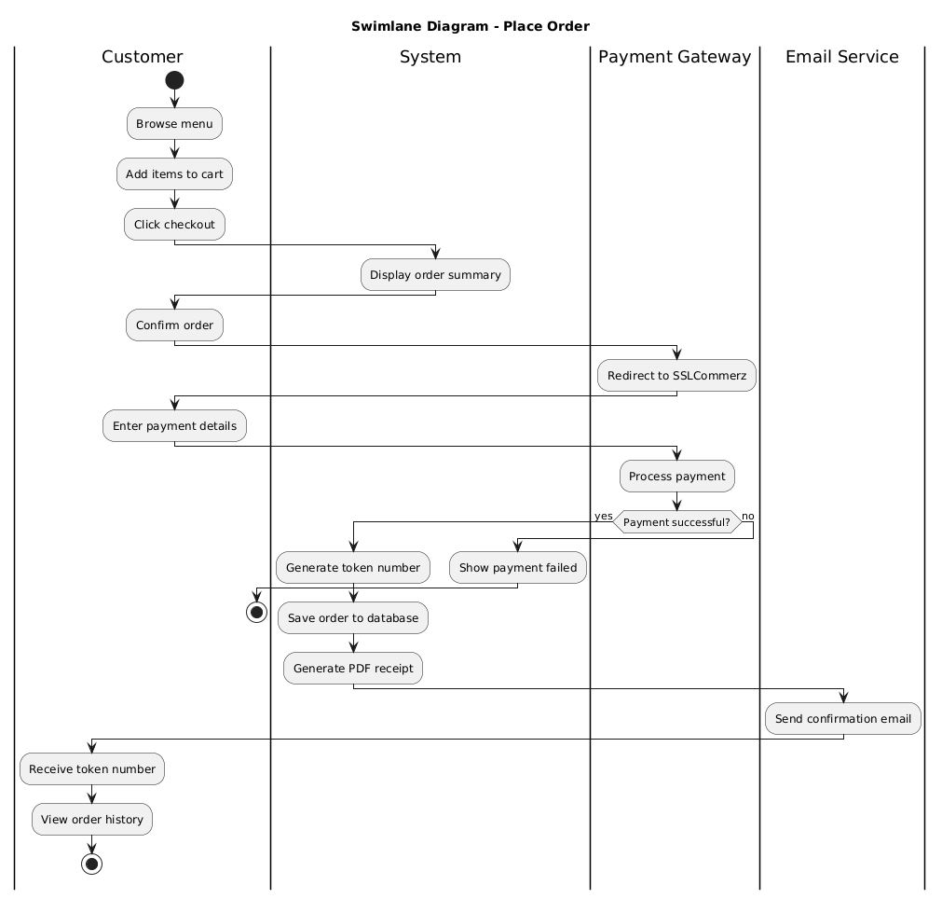
63

Slide 64
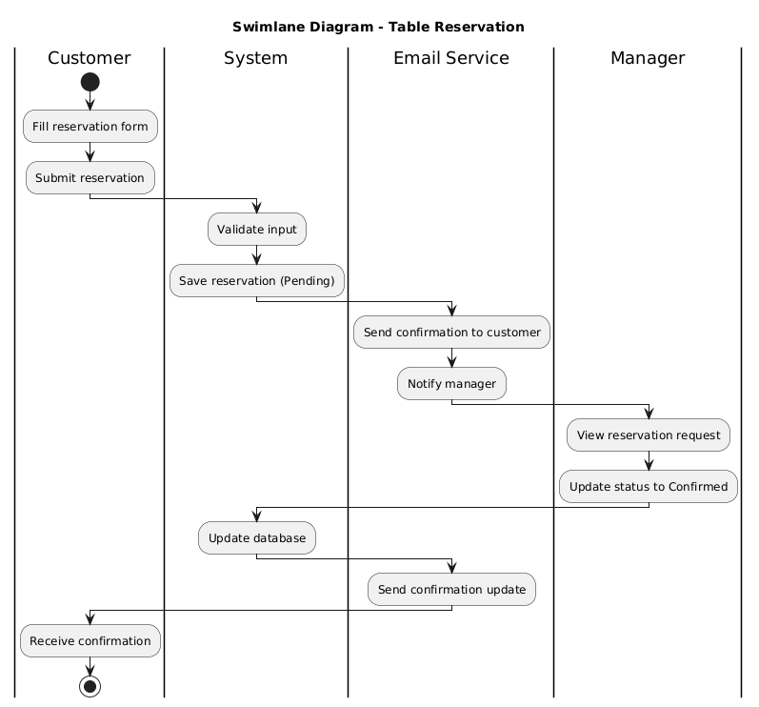
64

Slide 65
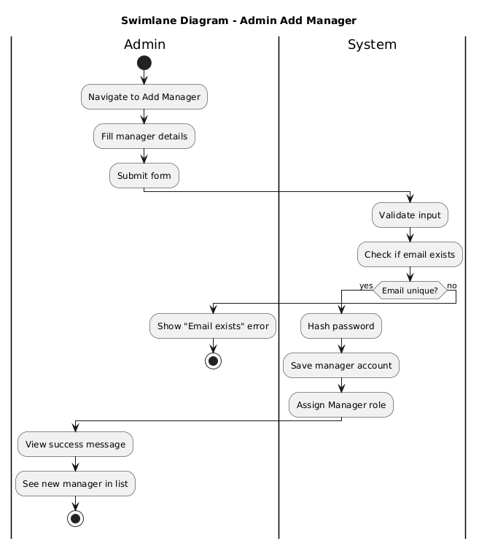
65

Slide 66

66

Slide 67

67

Slide 68

68

Slide 69

69

Slide 70

70

Slide 71

71

Slide 72

72

Slide 73

73

Slide 74

73

Slide 75

75

Slide 76

76

Slide 77
77

Slide 78

78

Slide 79
79

Slide 80
80

Slide 81
81

Slide 82
82

Slide 83
83

Slide 84

84

Slide 85

85

Slide 86

86

Slide 87
87

Slide 88
88

Slide 89
89

Slide 90
90

